Slide 1
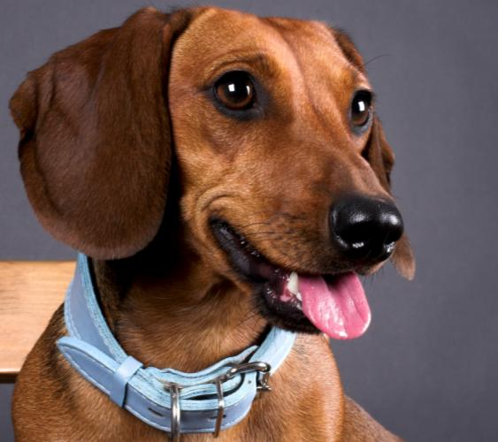
15-1 POSSESSIVE NOUNS
The dog has a collar.
The dog’s collar is blue.

Slide 2
15-1 POSSESSIVE NOUNS
Its collar is blue.
The dog’s collar is blue.

Slide 3
15-1 POSSESSIVE NOUNS
The dog’s name is Pancracio.

Slide 4
15-1 POSSESSIVE NOUNS
(a) The dog has a collar.
The dog’s collar is blue.
(b) My sister has a son.
My sister’s son is a student.
SINGULAR NOUN
POSSESSIVE
FORM
SINGULAR NOUN
POSSESSIVE
FORM

Slide 5
15-1 POSSESSIVE NOUNS
(a) The dog has a collar.
The dog’s collar is blue.
(b) My sister has a son.
My sister’s son is a student.
POSSESSIVE NOUN, SINGULAR:
noun + apostrophe ( ) + -s
’

Slide 6
15-1 POSSESSIVE NOUNS
(c) The dogs have collars.
The dogs’ collars are blue.
(d) My sisters have sons.
My sisters’ sons are students.
PLURAL NOUN
POSSESSIVE
FORM
PLURAL NOUN
POSSESSIVE
FORM

Slide 7
15-1 POSSESSIVE NOUNS
(c) The dogs have collars.
The dogs’ collars are blue.
(d) My sisters have sons.
My sisters’ sons are tall.
POSSESSIVE NOUN, PLURAL:
noun + -s + apostrophe ( )
’

Slide 8
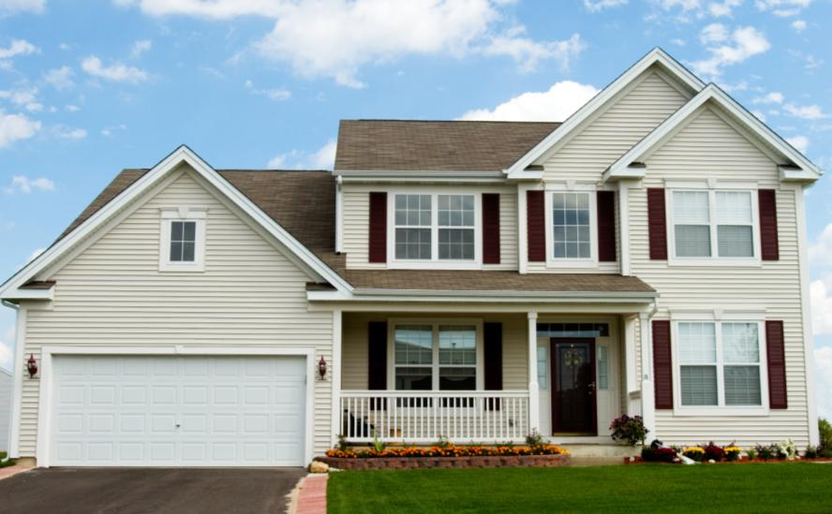
15-1 Let’s Practice
‘
?
Marinas house is big.

Slide 9

15-1 Let’s Practice
‘
?
‘
He is my sister s husband.

Slide 10
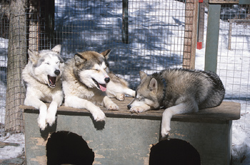
15-1 Let’s Practice
‘
?
The dogs have a house.
The dogs house is crowded.
‘
?

Slide 11
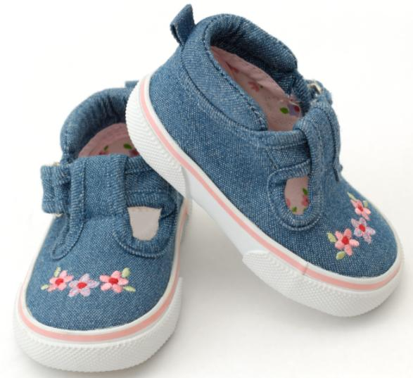
15-2 POSSESSIVE: IRREGULAR PLURAL NOUNS
These are
children’s shoes.

Slide 12
15-2 POSSESSIVE: IRREGULAR PLURAL NOUNS
(a) These are children’s shoes.
(b) These are men’s shoes too.
(c) These are women’s shoes.
(d) People’s names are difficult to pronounce.
children
men
women
people
irregular plural
nouns

Slide 13
15-2 POSSESSIVE: IRREGULAR PLURAL NOUNS
(a) The factory produces children’s shoes.
(b) That factory produces men’s shoes too.
(c) It also produces women’s shoes.
(d) People’s names are hard to say.
REGULAR PLURAL POSSESSIVE NOUN:
the girls’ teacher
IRREGULAR PLURAL POSSESSIVE NOUN:
the men’s shoes

Slide 14
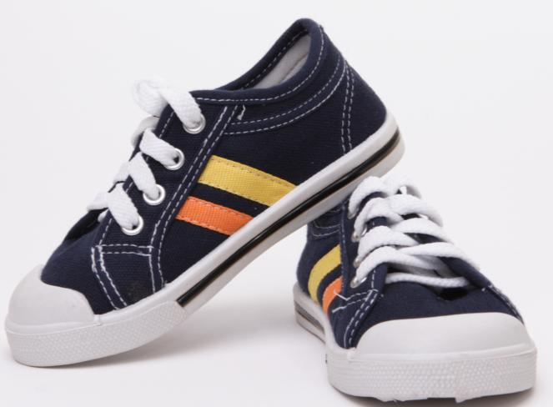
15-2 Let’s Practice
Tyler
These are ______ shoes.
Tyler’s

Slide 15
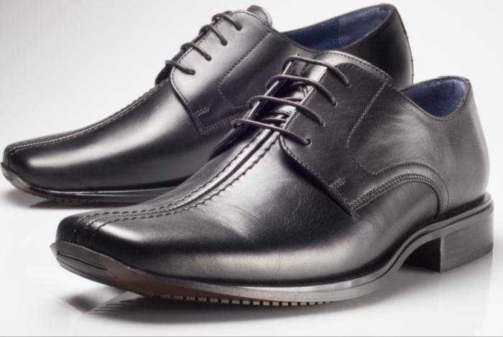
15-2 Let’s Practice
men
They’re _____ shoes.
men’s

Slide 16
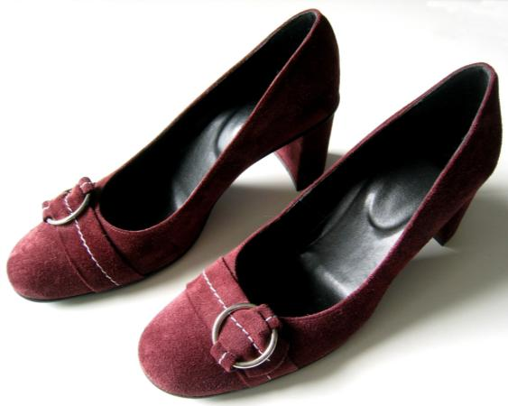
15-2 Let’s Practice
women
They’re ________ shoes.
women’s

